Slide 1
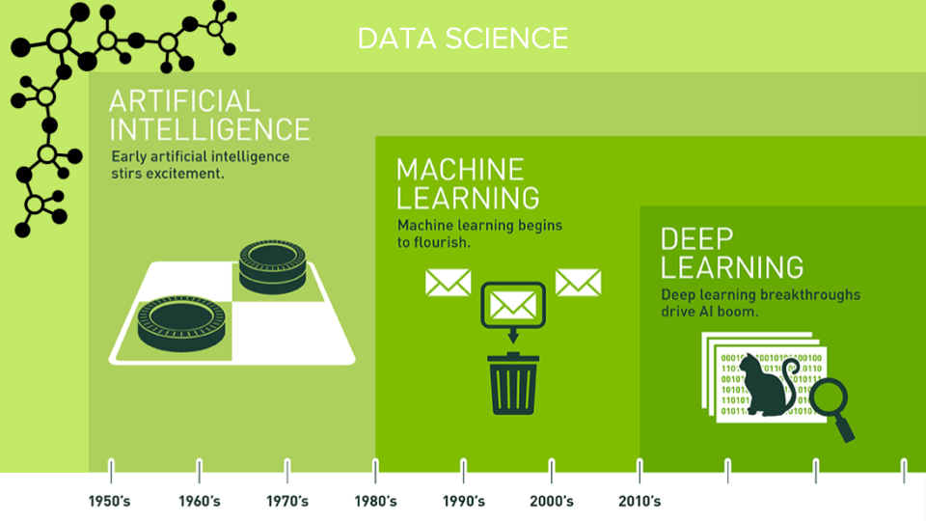
Artificial Intelligence
In general, any machine learning problem can be assigned to one of two broad
classifications:
supervised learning
OR
unsupervised learning.

Slide 2
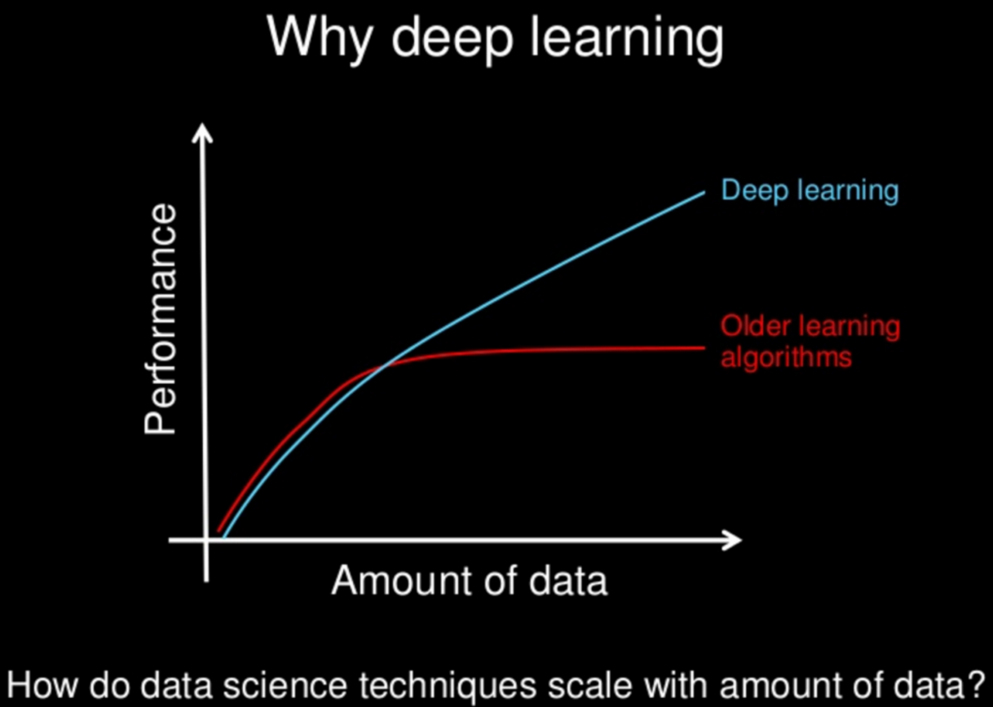
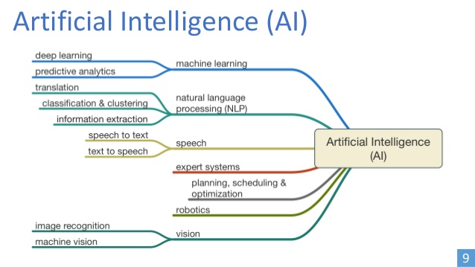

Slide 3
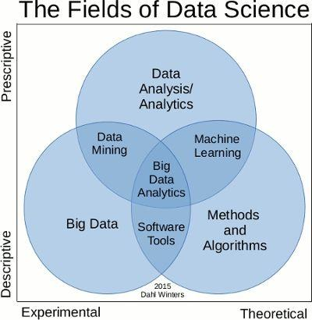
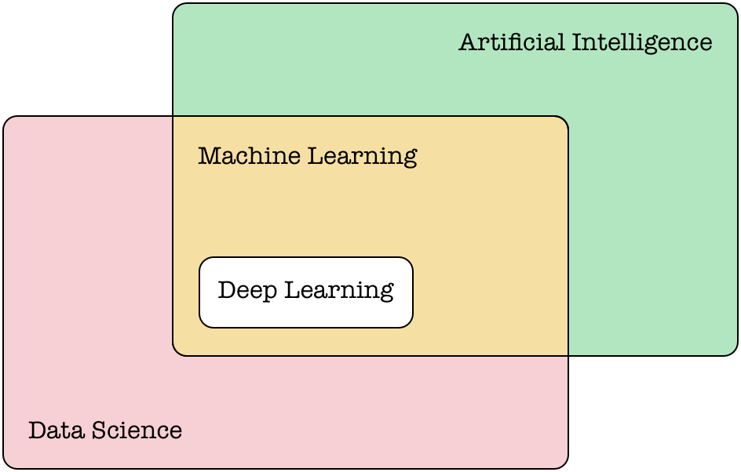

Slide 4
Supervised learning problems are categorized into "regression“(continuous output) and "classification“(discrete output) problems.
Unsupervised learning, allows us to approach problems with little ono idea what our results should look like. We can derive this structure by clustering the data based on relationships among the variables in the data.
Deep Learning,The learning algorithm of a neural network can either be supervised or unsupervised. imp

Slide 5
Our hypothesis function has the general form:
y^ = hθ(x) = θ0 +θ1x
We can measure the accuracy of our hypothesis function by using a cost function(Squared error function)
If we try to think of it in visual terms, our training data set is scattered on the x-y plane. We are trying to make straight line which passes through this scattered set of data.
Our objective is to get the best possible line. The best possible line will be such so that the average squared vertical distances of the scattered points from the line will be the least.
In the best case, the line should pass through all the points of our training data set. In such a case the value of J(θ0,θ1) will be 0.

Slide 6
So we have our hypothesis function and we have a way of measuring how well it 􀃒ts into the data. Now we
need to estimate the parameters in hypothesis function. That's where gradient descent comes in.
The way we do this is by taking the derivative (the tangential line to a function) of our cost function. The slope
of the tangent is the derivative at that point and it will give us a direction to move towards. We make steps
down the cost function in the direction with the steepest descent, and the size of each step is determined by
the parameter α, which is called the learning rate.
The point of all this is that if we start with a guess for our hypothesis and then repeatedly apply these gradient
descent equations, our hypothesis will become more and more accurate

Slide 7
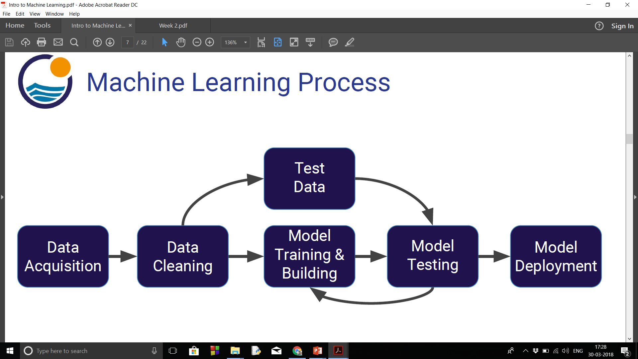

Slide 8
Introduction
.How do I know which model to choose for my problem?
First, you need to figure out whether your problem is linear or non linear. Then:
If your problem is linear, you should go for Simple Linear Regression if you only have one feature, and Multiple Linear Regression if you have several features.
If your problem is non linear, you should go for Polynomial Regression, SVR, Decision Tree or Random Forest.

Slide 9
How can I improve each of these models ?
In Part 10 - Model Selection, you will find the second section dedicated to Parameter Tuning, that will allow you to improve the performance of your models, by tuning them. You probably already noticed that each model is composed of two types of parameters:
the parameters that are learnt, for example the coefficients in Linear Regression,
the hyperparameters.
The hyperparameters are the parameters that are not learnt and that are fixed values inside the model equations. For example, the regularization parameter lambda or the penalty parameter C are hyperparameters. So far we used the default value of these hyperparameters, and we haven't searched for their optimal value so that your model reaches even higher performance. Finding their optimal value is exactly what Parameter Tuning is about.

Slide 10
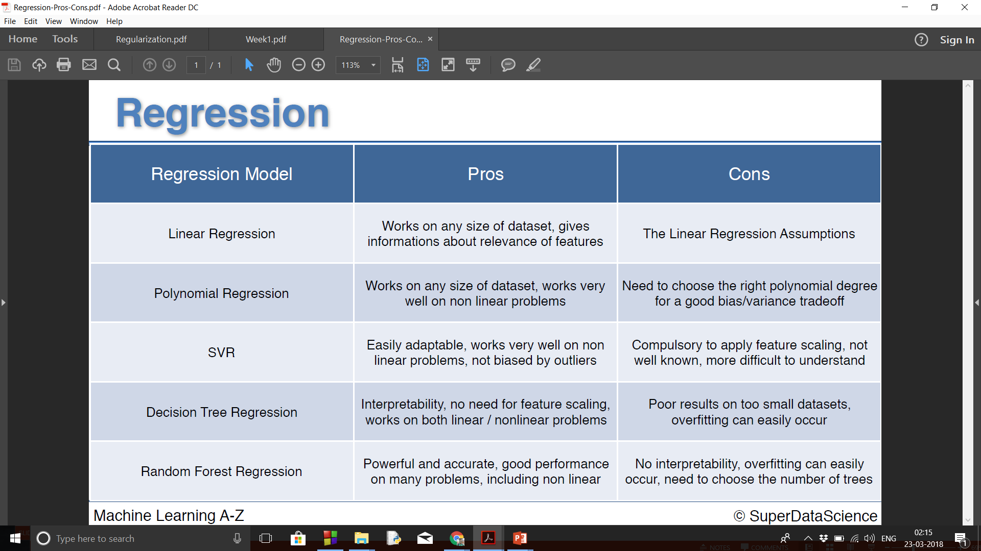

Slide 11
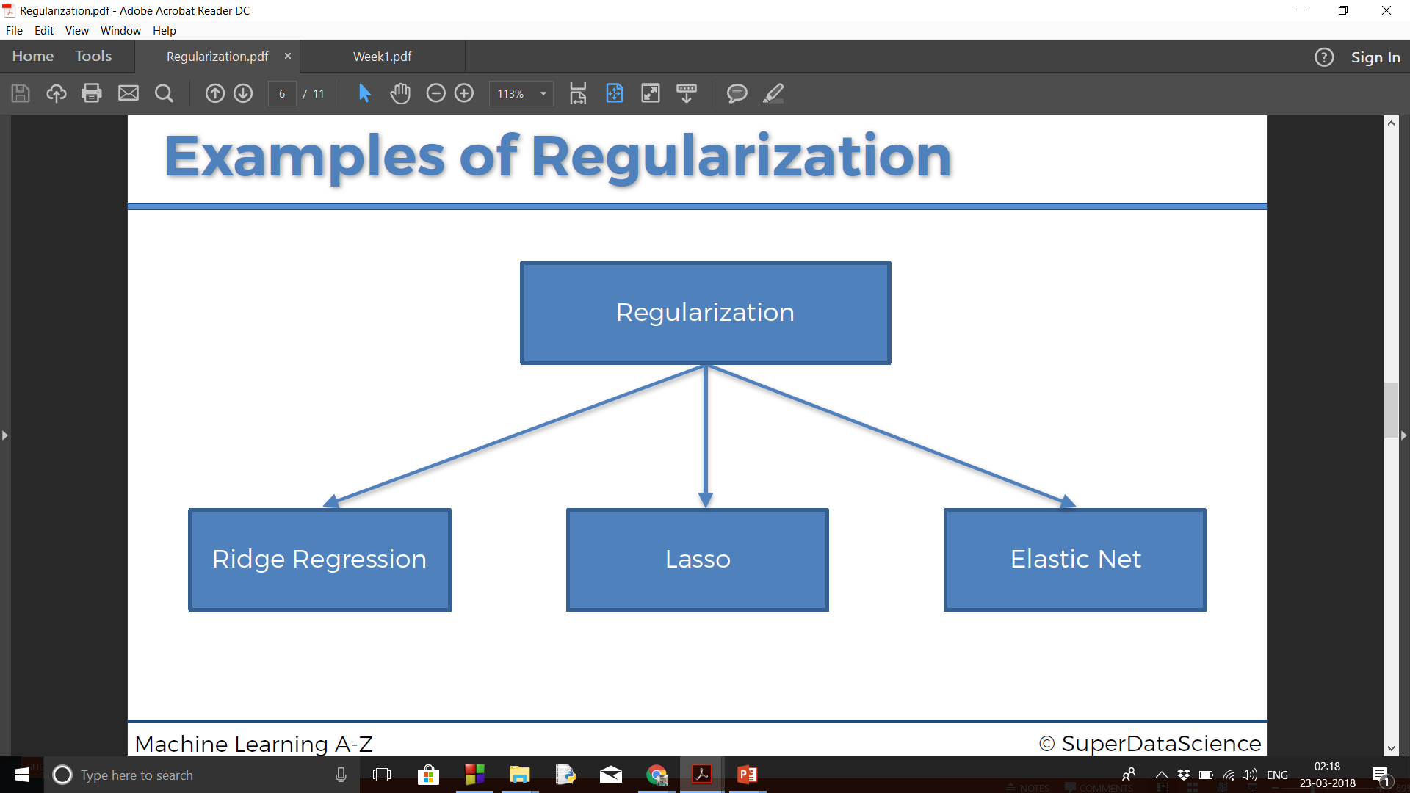
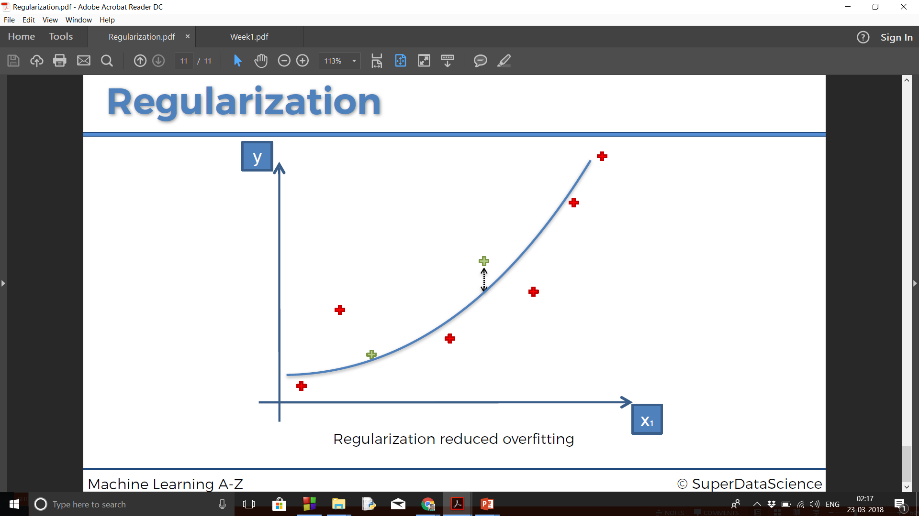

Slide 12
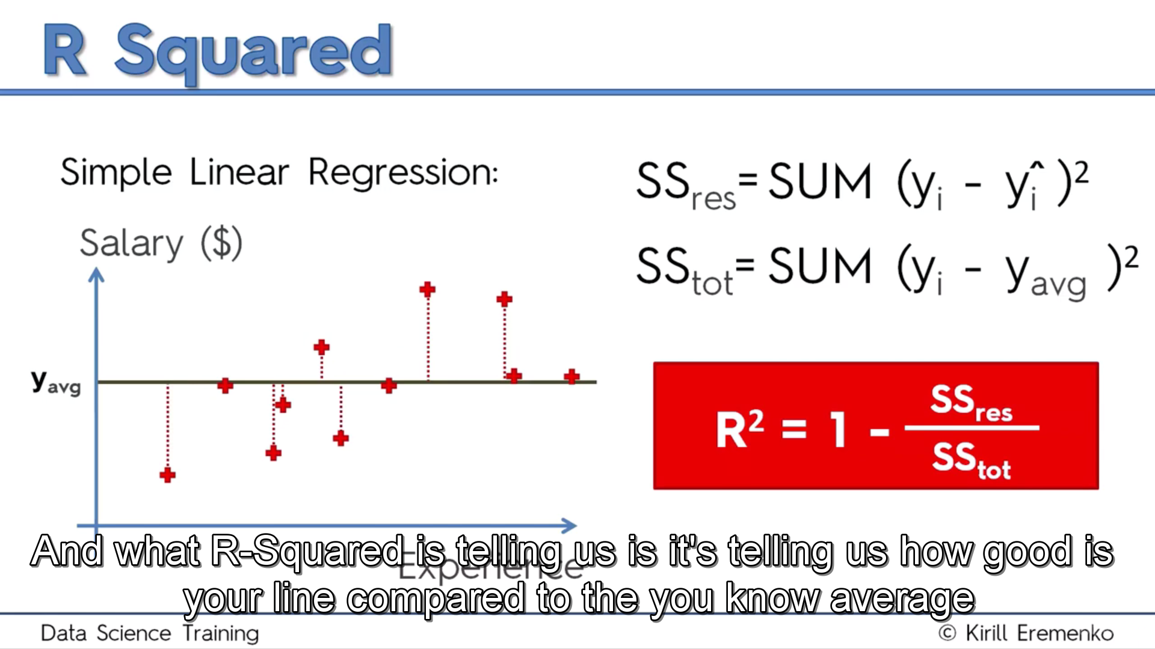
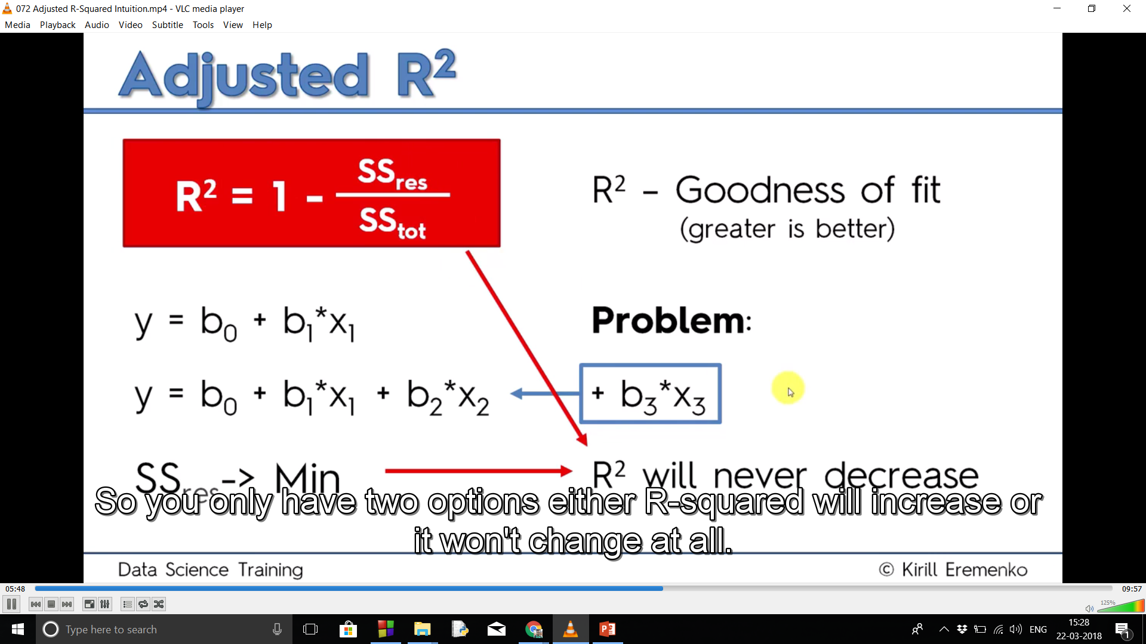
Notes:
As Ssres tends to zero R^2 tends to 1 and model tends to ideality
Problem with R^2
You can add independent variables and you will not know if you are helping the model or not
Solution
Adjusted R^2

Slide 13
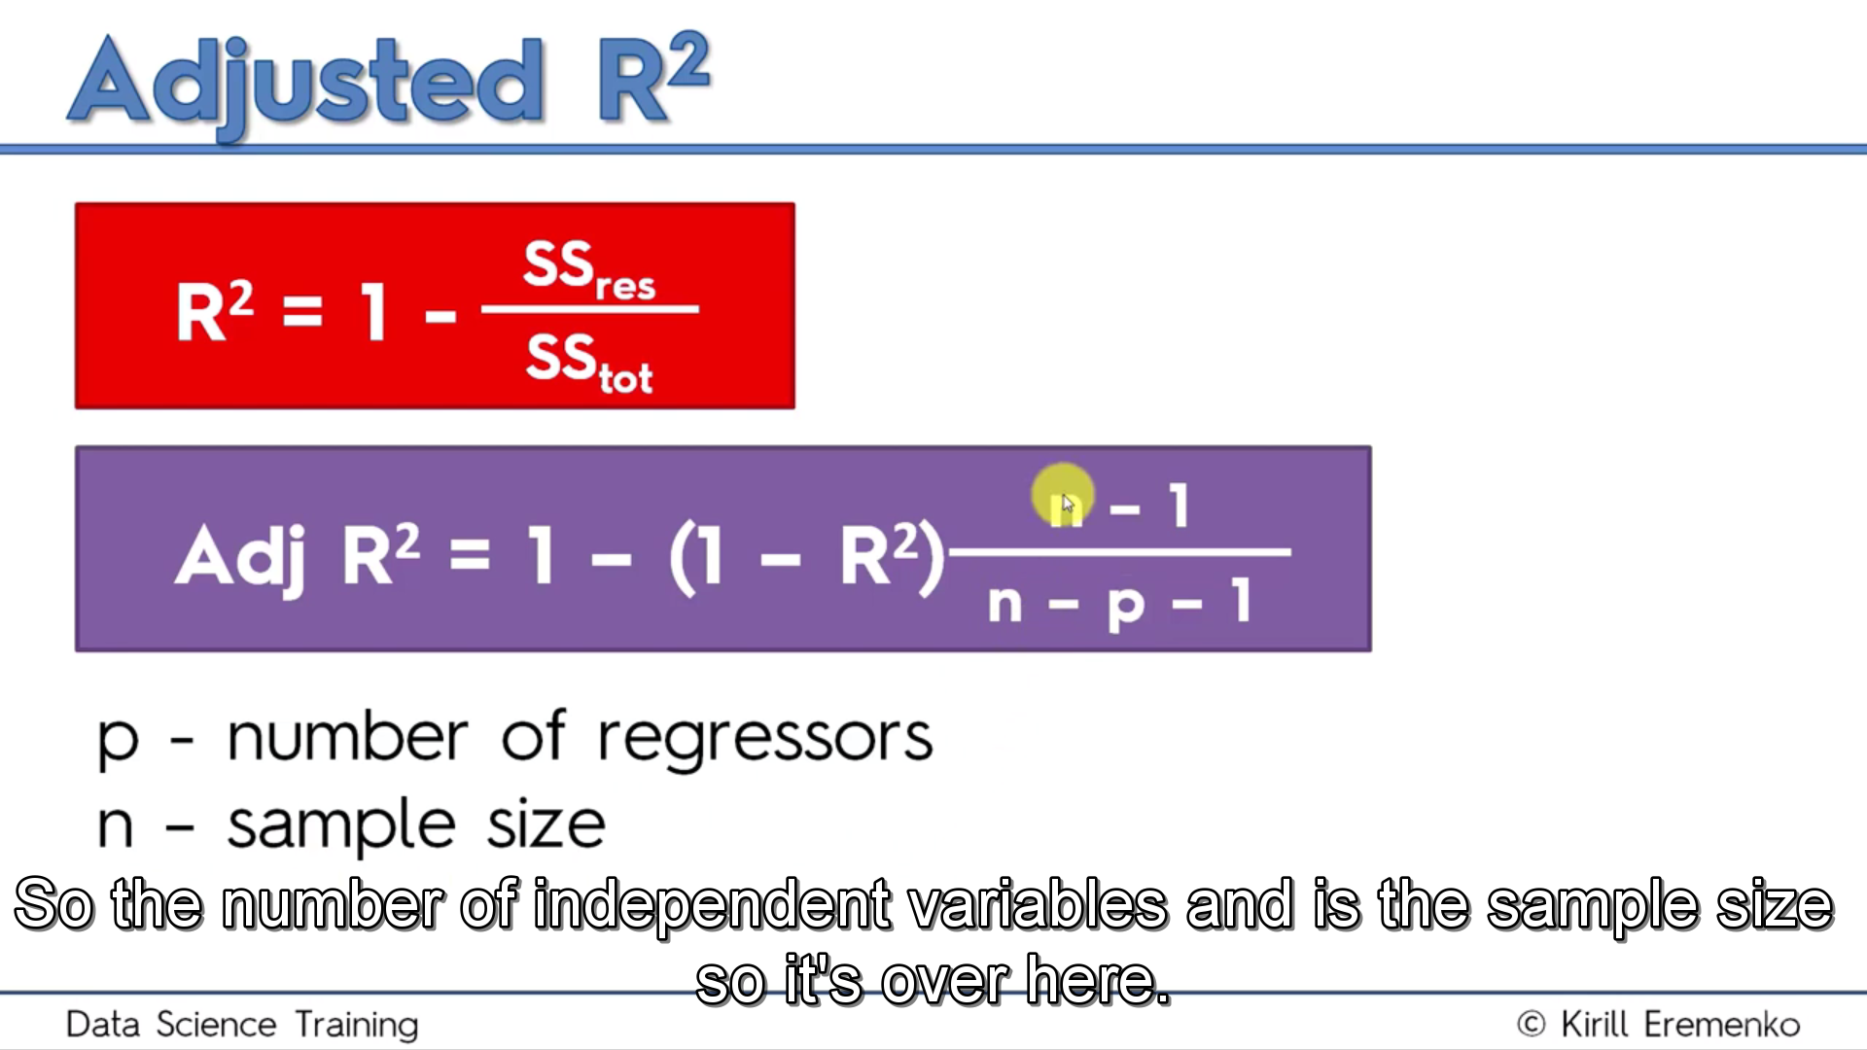
p Is the number of independent variables
On adding a independent variable R^2 increases and adjusted R^2 decreases
If independent variable is not helping the model then there would be decrease in adjusted R^2
For different combinations of independent variables increase in adjusted R^2 signifies better model
And decrease in adjusted R^2 signifies bad model

